Slide 1


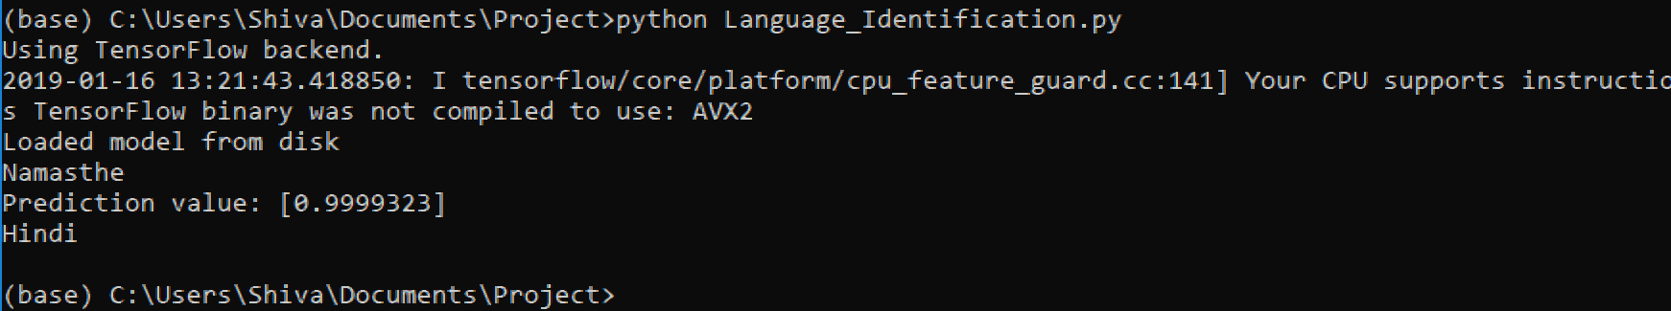
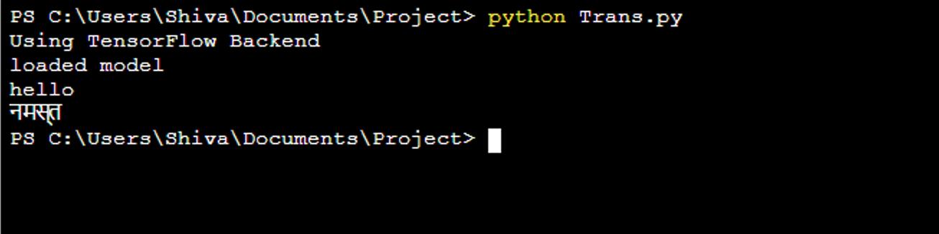
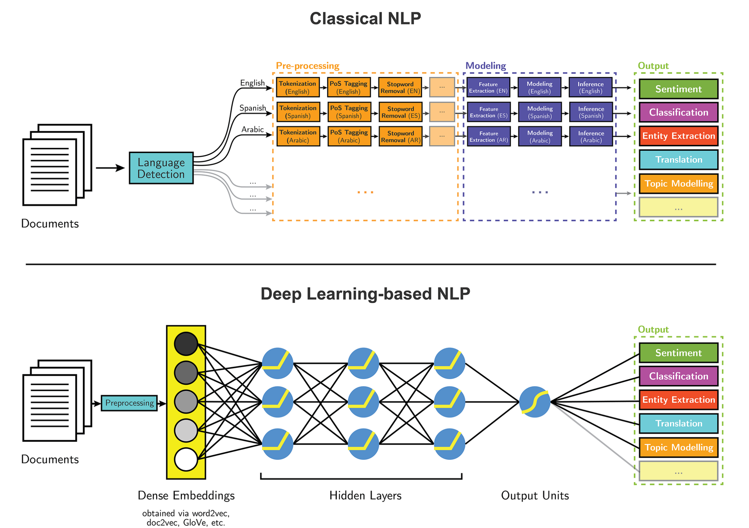
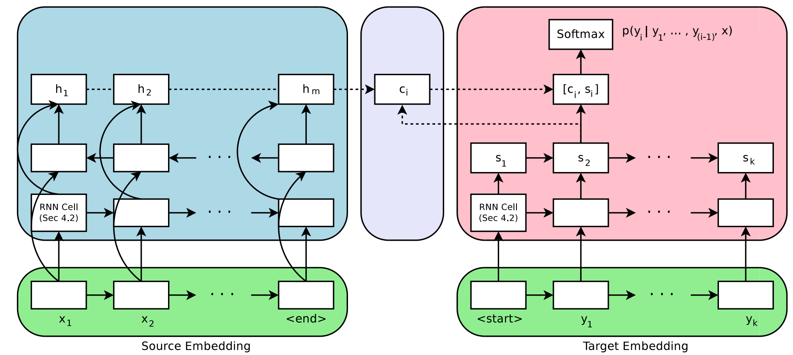


Roman to Devanagari conversion for code-mixed language
Group members: Ambuje Gupta, Uday Agarwal, Shiva Ganesh, Monisha
Mentors: Sheryans/Prof. Biswas
Abstract
Nowadays people are not very particular about expressing themselves in pure Hindi or pure English. But they tend to mix them up. This project is aimed at understanding code-mixed words written on social media. Mainly we group the words in three categories: English, Hindi and code-mixed We will take the code-mixed words and try to identify whether the word is English or Hindi and then we convert it into Devanagari form. Sufficient parallel transliteration pairs are needed for training state of the art transliteration model.
khareedaaree
kitne
खरीदारी
किताब
कितने
Fig.2 Output Language Identification model
kya
book
khush
क्या
खुश
We used around 22000 English Hindi parallel corpus to train the translation model and 5000 pairs of parallel corpus for evaluating that model. We are using char by char method so that the model can learn the morphological difference between the words and it will be predicting the correct meaning even though it haven't seen the word before. The snap of the output is given below.
tyauhaar
Namaste
त्यौहार
नमस्ते
Introduction
Neural Machine Translation is one of the approach to machine translation. Unlike the traditional phrase-based translation system which consists of many small sub-components that are tuned separately, neural machine translation attempts to build and train a single, large neural network that reads a sentence and outputs a correct translation. characters of those languages are hypothesized which encode different features. Thus the character structure is captured for both the languages. The identified words are then translated by using encoders-decoders LSTM network(Ref.Fig.1).
Fig.3 Output of Translation model
If the model is given the input of words whose length is higher than that of the length of the words in training corpus its difficult for the network to cope. So each time the model generates a word in a translation, it searches for a set of positions in a source sentence where the most relevant information concentrated. Then the model predicts a target word based on the context vectors associated with these source position and all the previous generated target words.
Encoder LSTM
Attention
Decoder LSTM
Diagrammatic representation of Classical NLP and Deep-Learning Based NLP(Fig.1)
Proposed Method
Fig.4
Diagrammatic Representation of encoder and decoder
Our flow of work:
Build a token level language identification model
Build a translation model for English words and transliteration model for Hinglish words.
Our contribution towards creating the model:
Char by char method is used for training our model.
The character structure is captured for each language.
Thus model understand the morphological difference between the English and the Hindi words.
Encoder and Decoder are used in our model where encoder encodes the source word and decoder outputs translation from encode vector(Ref.Fig.4).
Conclusions
.
Perhaps more importantly the proposed approach (encoder and decoder) achieved a translation performance comparable to existing phrase-based statistical machine-translation. We believe that the architecture proposed here is promising step towards better machine translation and a better understanding of natural language in general.
Experimental Results and Discussion
We ran our language identification model on around 12500 labelled English and Hinglish words. Each of these tokenized words are of two classifications namely English and Hindi. The final result was predicted as Hindi when the predicted value is greater than 0.5 or else it will be a English word. The output have been shown in the Fig.2
References
http://www.scitepress.org/Papers/2018/66786/66786.pdf (Language-Identification)
Dzmitry Bahdanau, KyungHyun Cho, Jacobs University Bremen, Germany (19 May 2016) Neural Machine Translation by jointly learning to align and translate
Team No. - 20

